Slide 1
Systems Request
Note Taking Website
Soham Adhikary, Wentao Chen, Kimberly Ho, Kristen Jones, Paul Rajapandi, Catherine Vargas
Deliverable 1: IS 436 - 01

Slide 2
Systems Request
Project Sponsor: IT Manager
Business Need: Create a website for students and those alike to easily create notes using a site.
Reach new customers
Improve already existing similar sites
Alternatives for written note taking
Easy-to-access site
Provide more helpful features than competitors
Create free to use website with premium features

Slide 3
Systems Request
Business Requirements: Create an easy to use site for customers
Create notes from their devices
Able to keep their thoughts in one spot
Save on the go
Design and develop a good e-commerce
Include contact us page for easy to reach advice.

Slide 4
Systems Request
Business value: We expect students and those alike to use this program to easily create notes for school, thoughts, and many more.
Special Issues or Constraints: There are many programs that also similarly allow for note taking. To stand out, this project must create an addition that is unique from all other websites and apps.

Slide 5
Feasibility Analysis
Primarily be used for students to have an easy method of note taking
Convenient for students.
Using a contact page
Users are able to give advice or ask questions
This project will start with:
Code script and website planning
Leading to a coding draft and a functional code
Create a frontend code draft to complete a running website.

Slide 6
Operational Feasibility
Site will be free to use
Addition of premium features
Increase revenue paying for any operational costs.
Make profit making it operationally feasible
Cost to create a website
Simple System
Should be little to no bugs that need to be fixed lowering production costs

Slide 7
Technical Feasibility
Easy and simple to implement
Smaller project
Many website creating apps and sites
Making process simpler

Slide 8
Organizational Feasibility
Many students and even those in office settings prefer to write their notes online
Able to preserve ideas
Seemingly unlimited space.
Additional space for customer feedback on site
Incorporates all the unique ideas and systems
Increase customer satisfaction
More business drawn to use our site.
Collaborate with our executives and board members
New ideas
Pricing for these new ideas and updates
Ie. Pen strokes to make the pen smoother, features such as recording lectures.

Slide 9
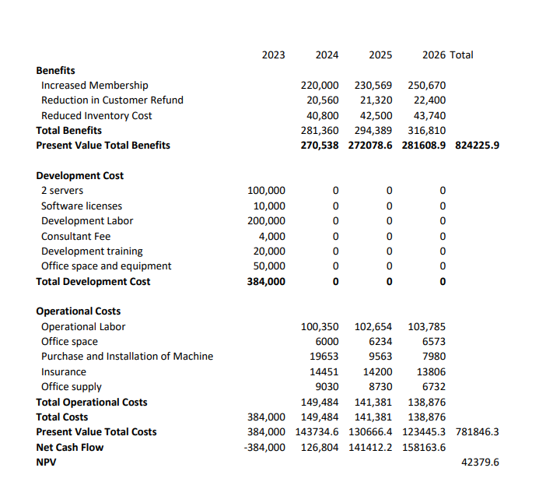
Cost - Benefits Analysis
Development Budget: 400,000
Total Present value benefits: 824225.9
Total Present value Cost: 781846.3
NPV: 42379.6 Positive

Slide 10
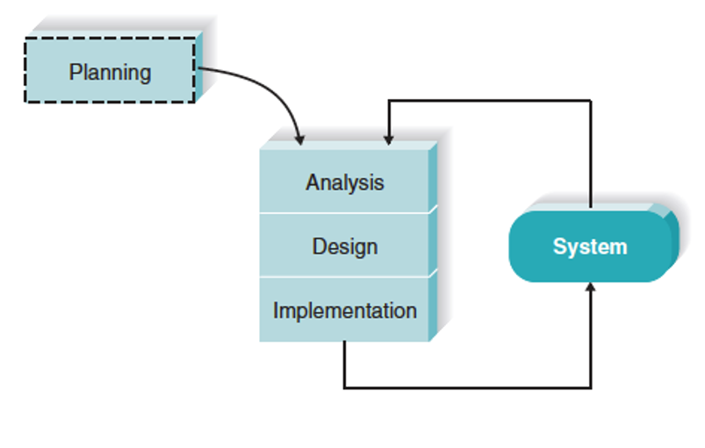
Methodology Selection: Agile Development

Slide 11
Why Agile Development?
There is a simplistic way of going about the project
Understanding where the planning phase, the design phase, breaking down the project to get the best results, etc.
Emphasis on trial and error
The results are delivered fast
Useful for projects that are still developing its requirements

Slide 12
Project Plan
Deliverable 1 due - 2/26
Begin planning code script and website design
Deliverable 3 due - 3/26
Complete backend code, have frontend code draft completed
Deliverable 5 - 4/23
Add edits, last minute additions or applications
3/12 - 3/25
4/9 - 4/22
Complete Project
2/26 - 3/11
3/26 - 4/8
4/23 - End
Deliverable 2 due - 3/17
Complete coding draft, have a functional code with an approved website design
Deliverable 4 due - 4/9
Complete code, have a running website
Regrouping Meetups:
Thursday 1:00 PM & Friday 6:00 PM

Slide 13
Team Roles
Soham Adhikary
Kimberly Ho
Wentao Chen
Project Manager
Data Manager
Frontend Developer
Project Management
Backend Developer
Business Analyst
Catherine Vargas
Paul Rajapandi
Kristen Jones
Data Analyst
Middle Tier Developer
Product Owner

Slide 14
Contact Information
Soham Adhikary :
Wentao Chen :
Kimberly Ho :
Kristen Jones :
Paul Rajapandi :
Catherine Vargas :
sadhika2@umbc.edu
wentaochen@umbc.edu
kho6@umbc.edu
kjones24@umbc.edu
gauthar1@umbc.edu
cvargas1@umbc.edu

Slide 15
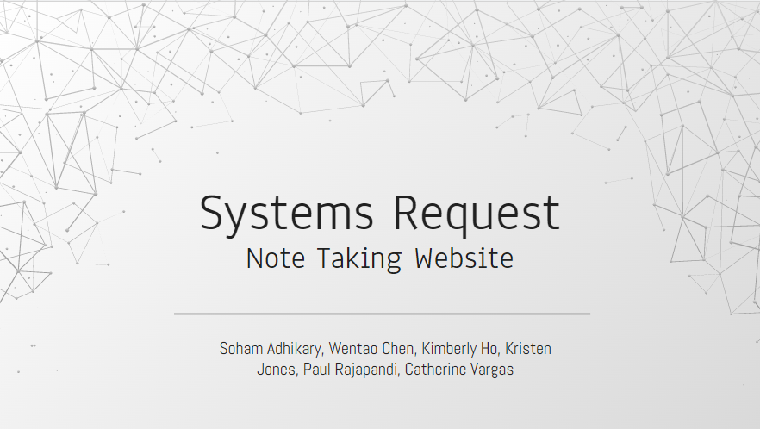
Thank
https://github.com/WentaoChen1/IS-436
You

